Slide 1
Optimizing the Video Streaming through Explicit QoE Analysis

Slide 2
Motivation
Heterogeneity
User:
User profile
QoE metrics (delay, stalling, bitrate), content
CDN:
CDN profile
QoE metrics
Performance
Fine-grained scheduling results in higher performance
Costs
Additional trade-off

Slide 3
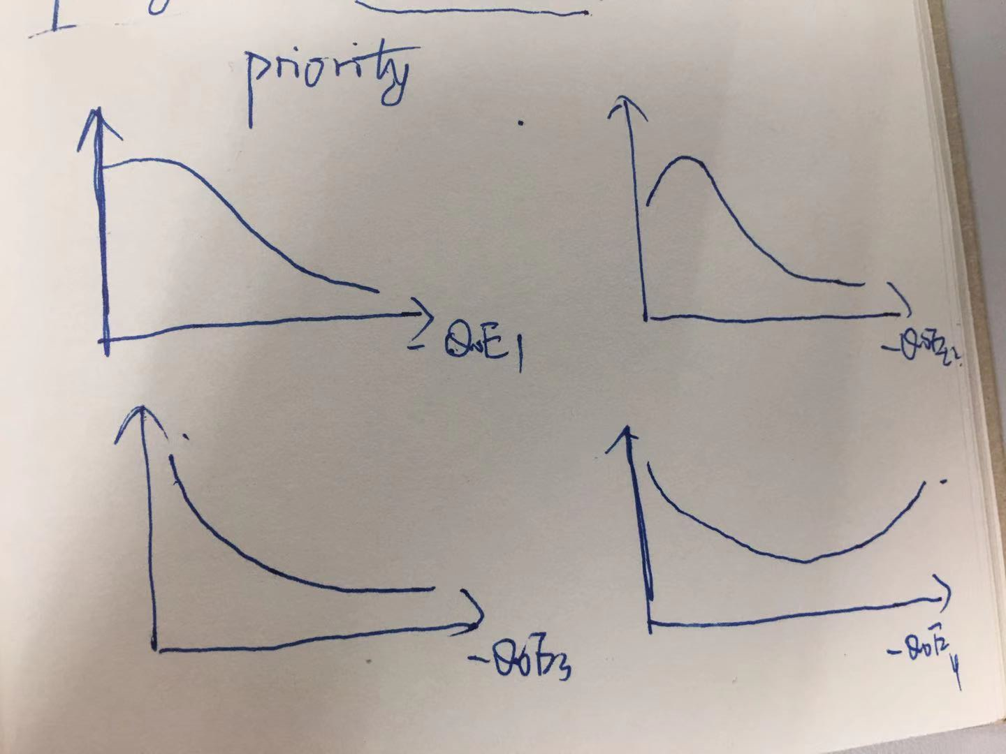
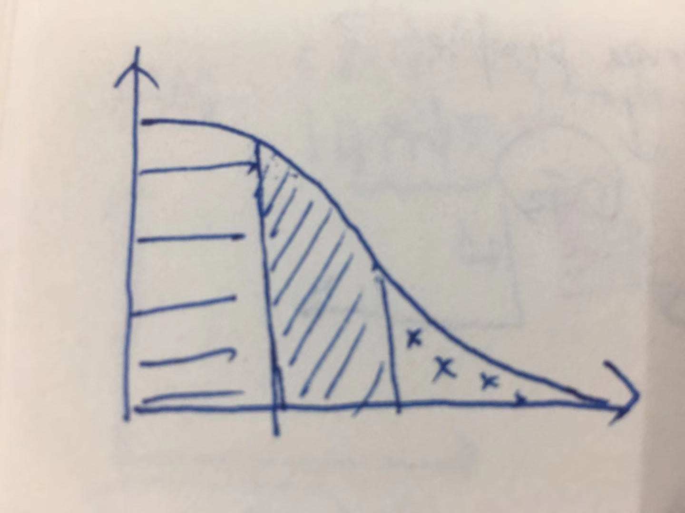
Motivation

Slide 4
Optimizing the Video Streaming through Explicit QoE Analysis
10/16

Slide 5

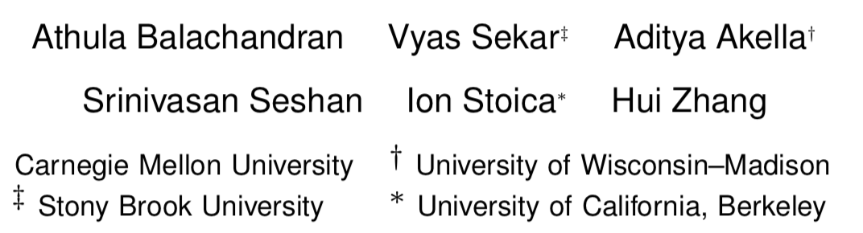

Slide 6
Motivation
Relationship between confounding factors and User Engagement
Complex relationship between quality and engagement
Dependencies between quality metrics
Confounding factors
it should be actionable to guide practical system design decisions.

Slide 7
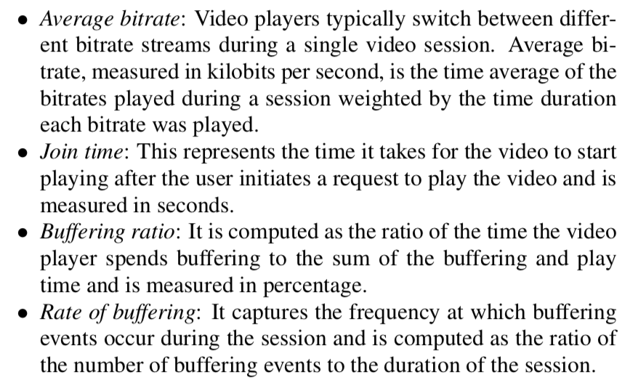
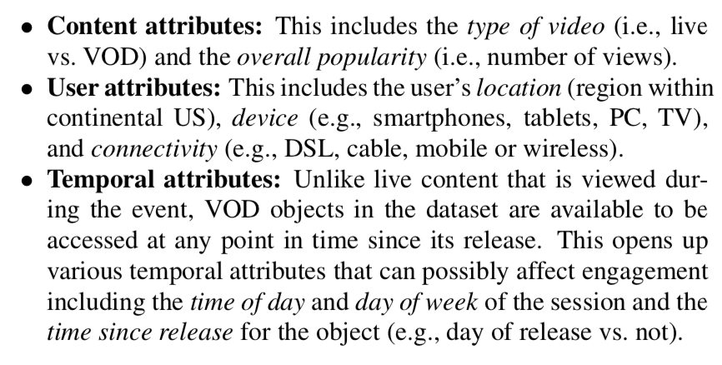
Metrics
QoS metrics
Confounding factors
No Interests

Slide 8
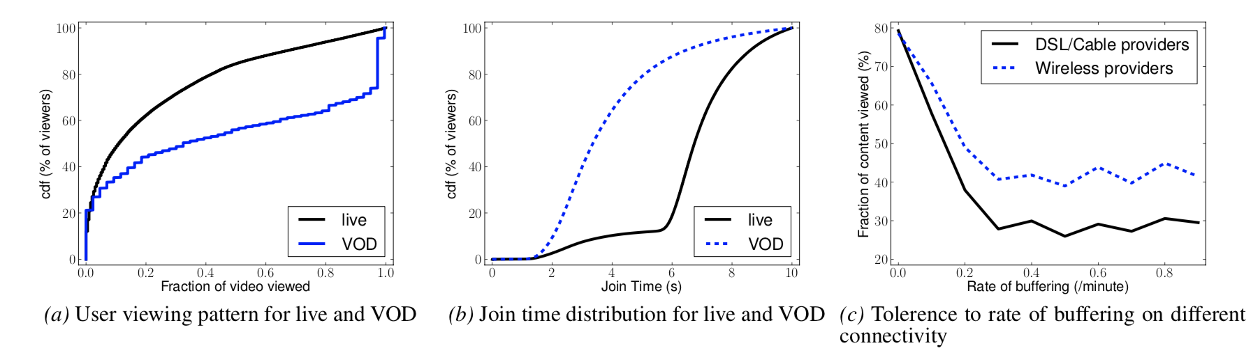
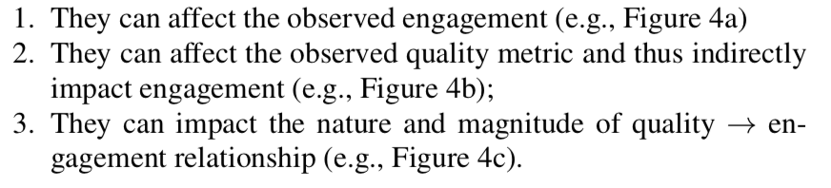
Insights

Slide 9
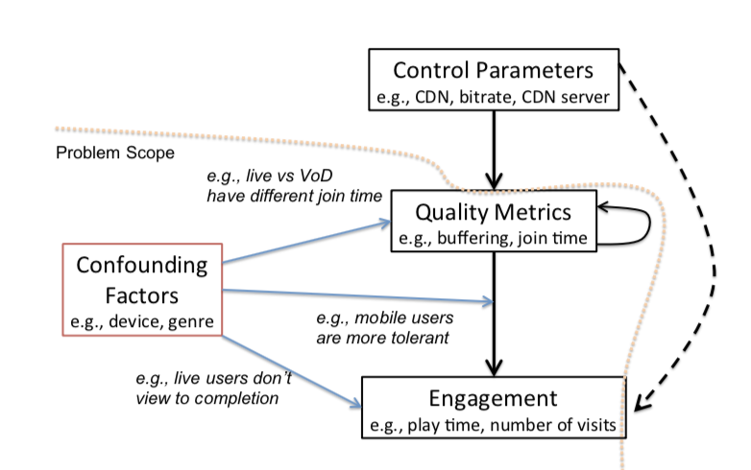
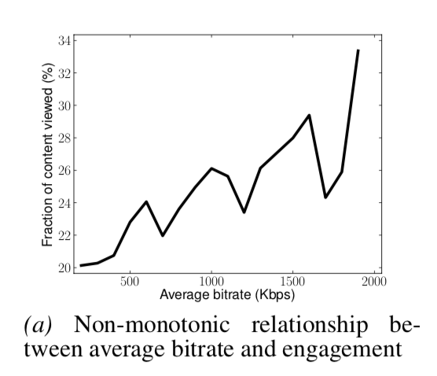
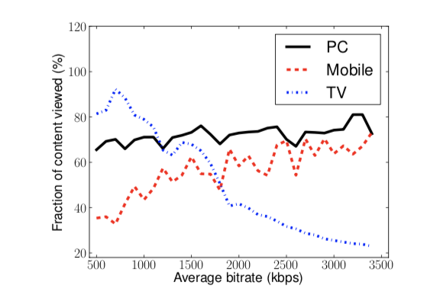
Insights
1. Decision Tree and Information Gain to estimate the relationship between QoS/Conf Factors.
1. QoS v.s Engagement after considering confounding factors
1. QoS v.s Engagement

Slide 10
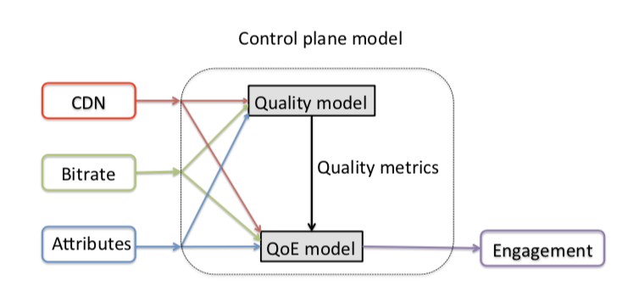
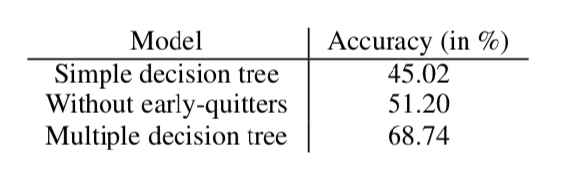
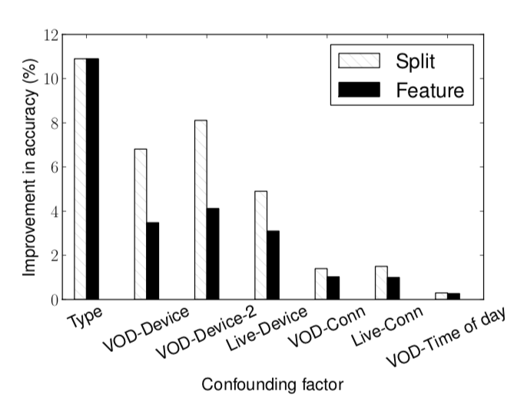
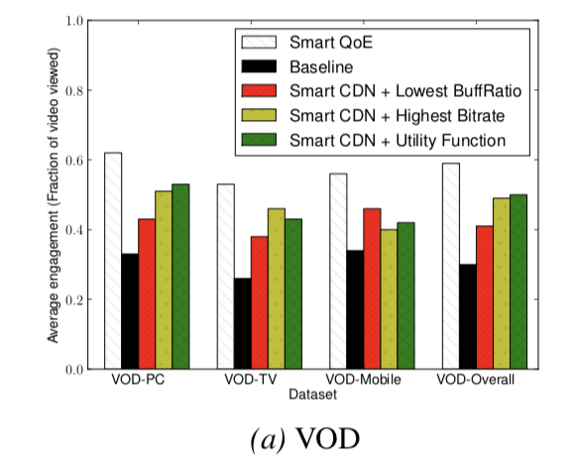
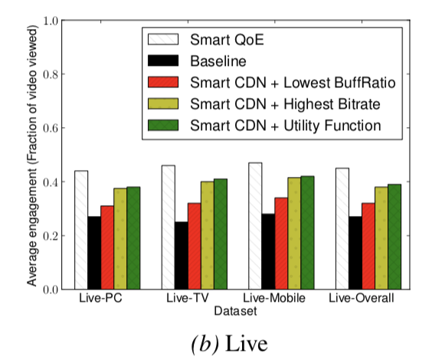
Results

Slide 11
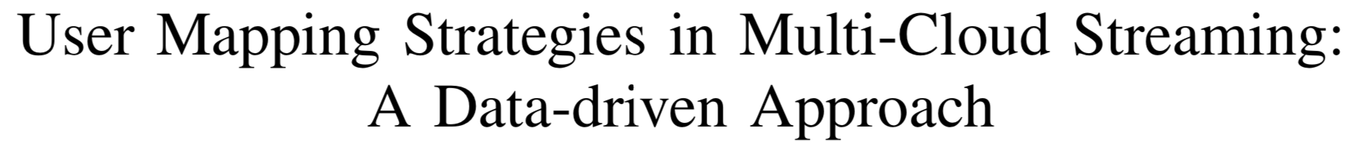
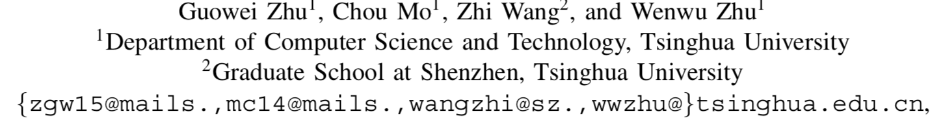

Slide 12
Motivation
First, rule-based user assignment cannot reflect the dynamics of the network performance
Only according to user’s location and hosting ISP.
Second, QoE in video streaming is affected by a variety of factors, including non-QoS factors.
QoS metrics: buffering ratio/rendering quality
User characteristics and behaviors
QoE-Aware CDN user mapping strategy.

Slide 13
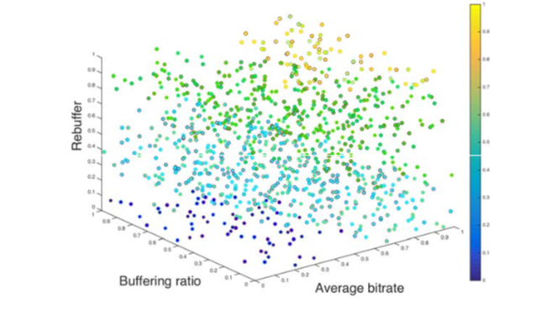
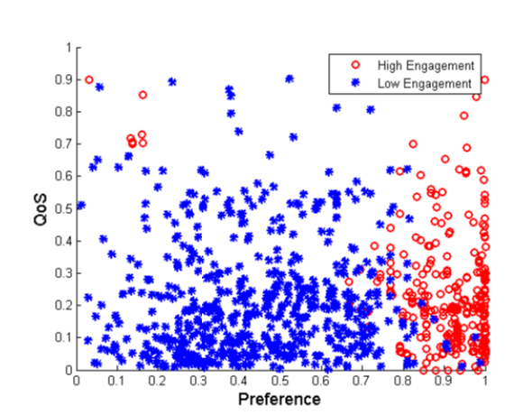
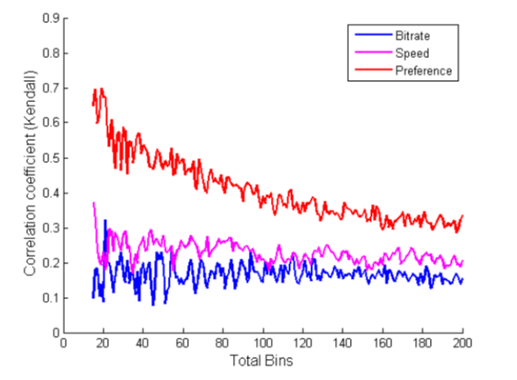

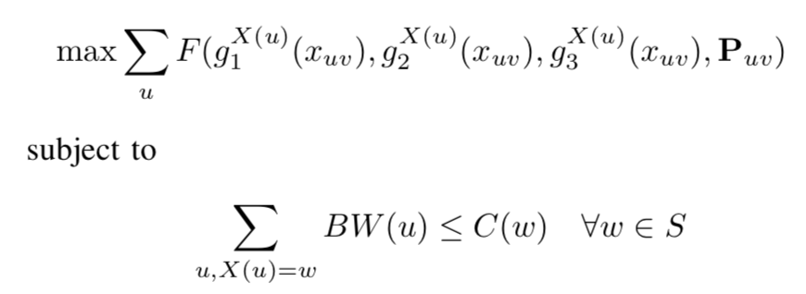
Design
1. Data-driven QoE mapping
Engagement is divided into two parts: high/low

Slide 14
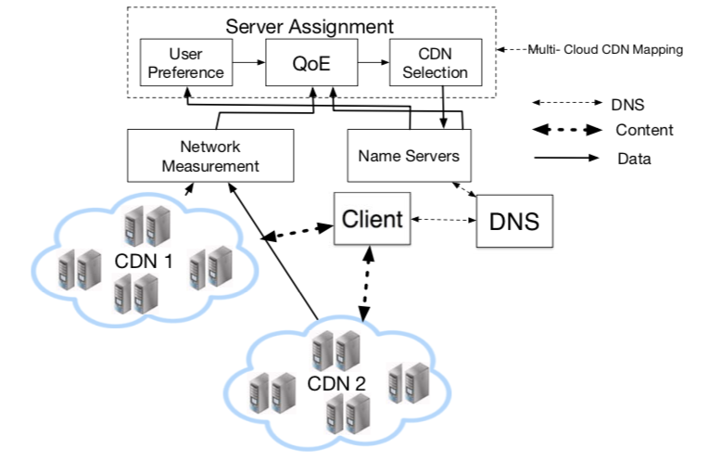
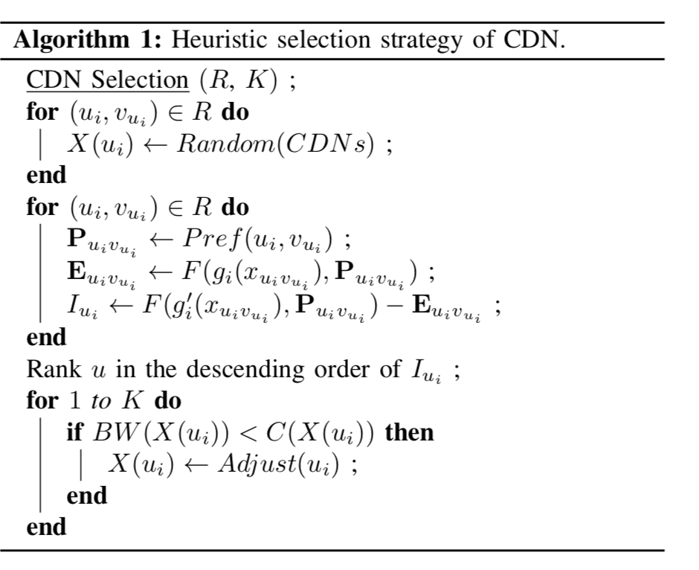
Design

Slide 15
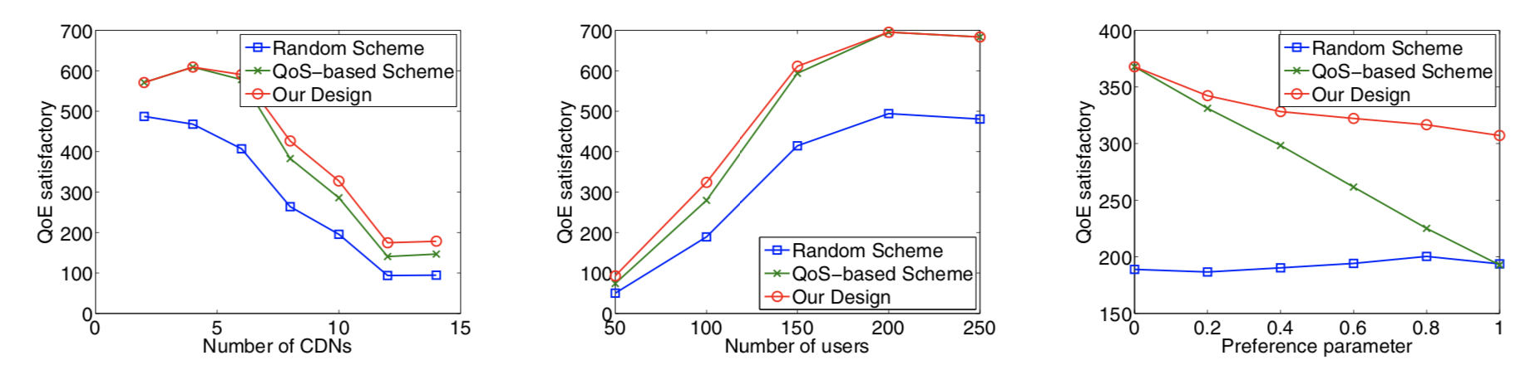
Results

Slide 16
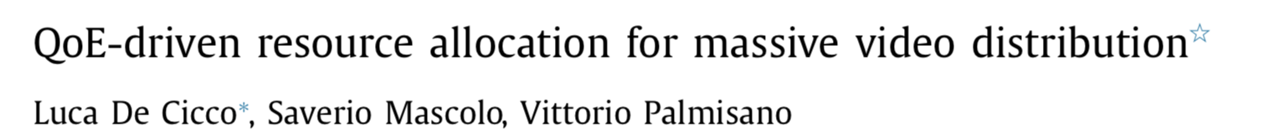

Slide 17
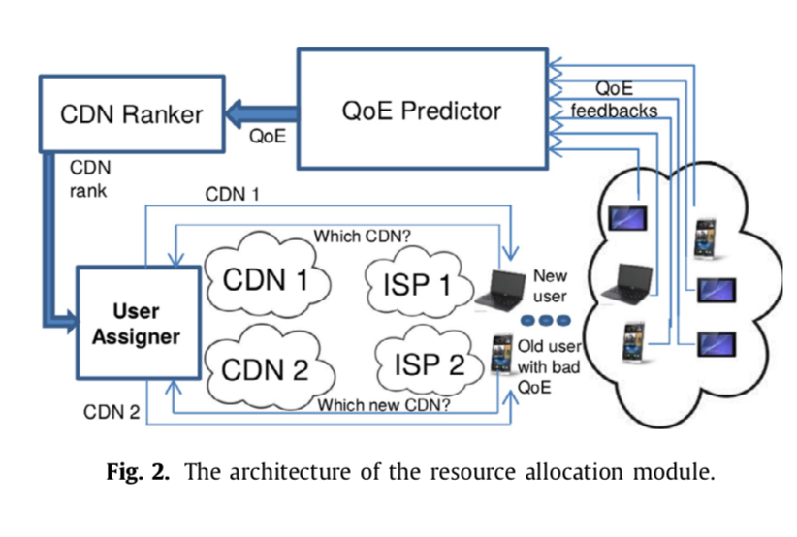

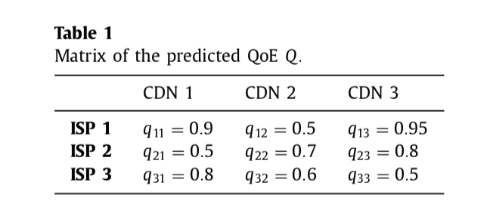
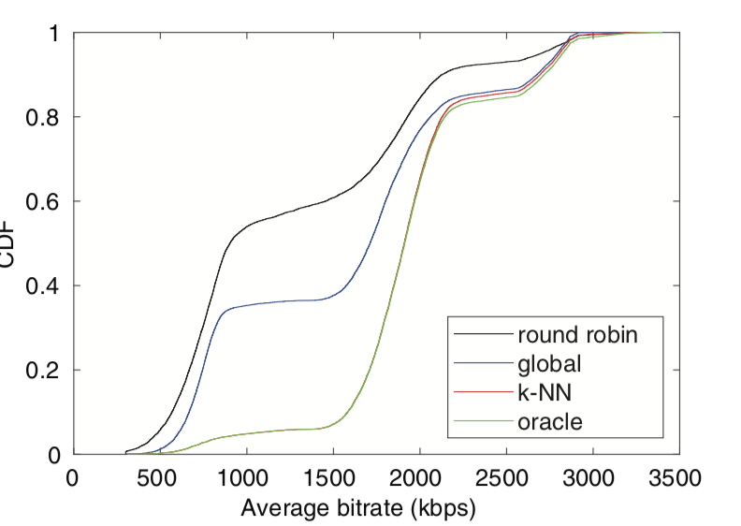
Design
Service: QoE predictor, K-means:
Client: DASH: ELASTIC

Slide 18


Slide 19
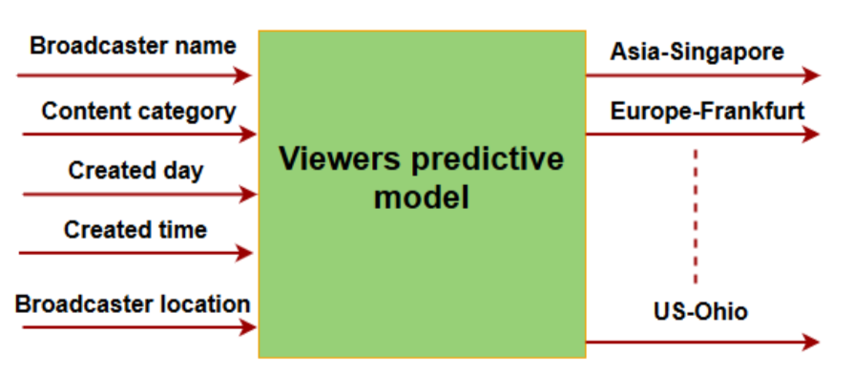
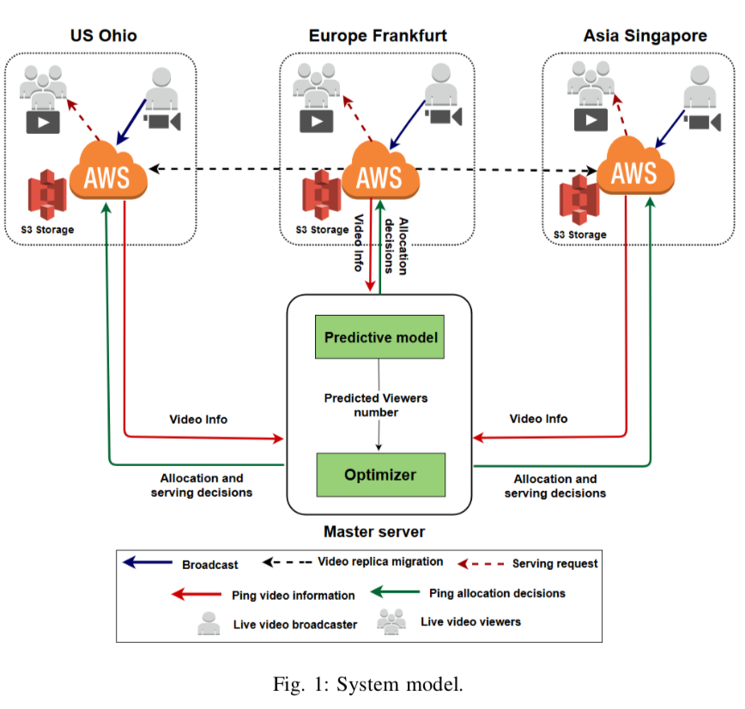
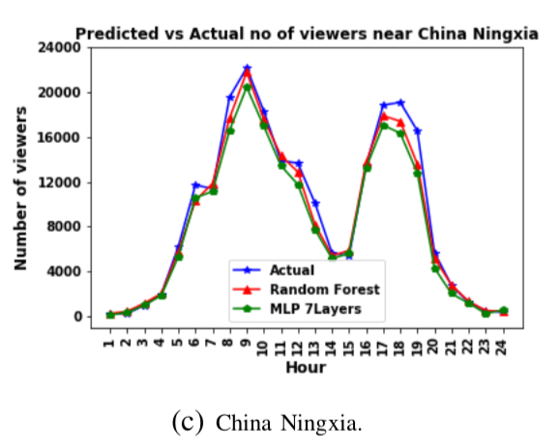
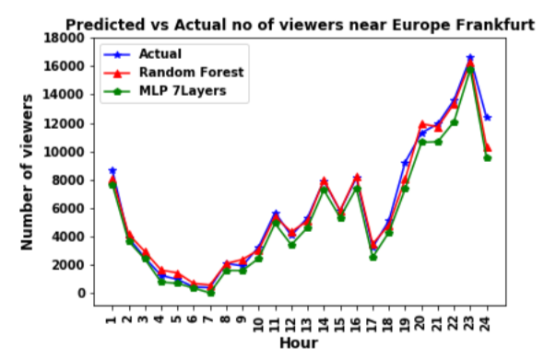

Slide 20
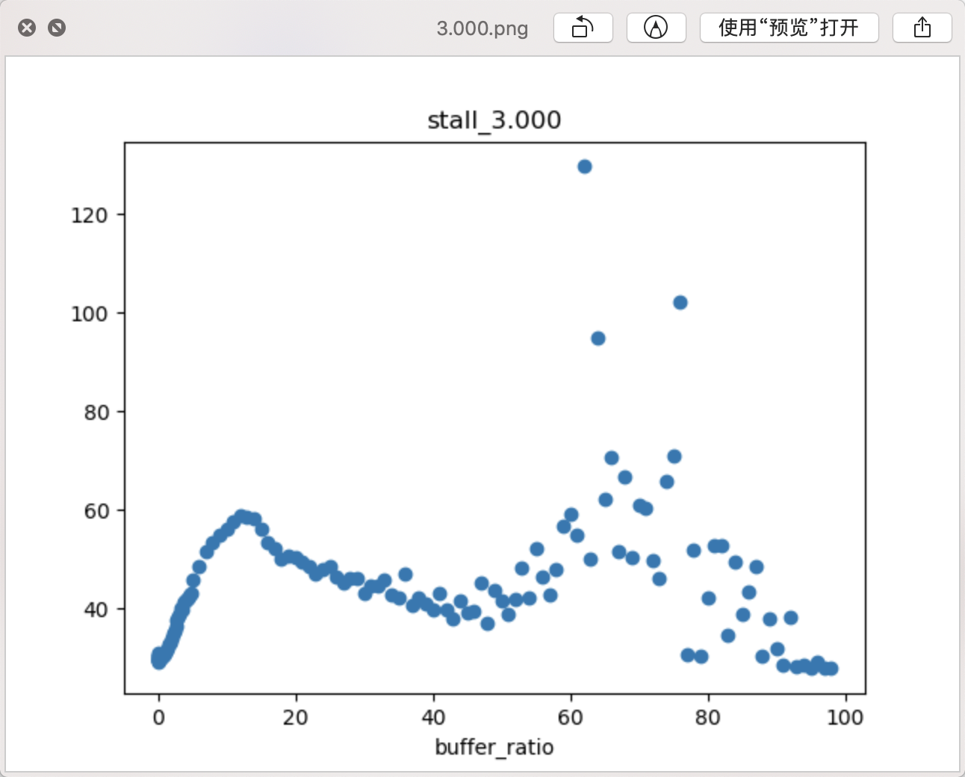
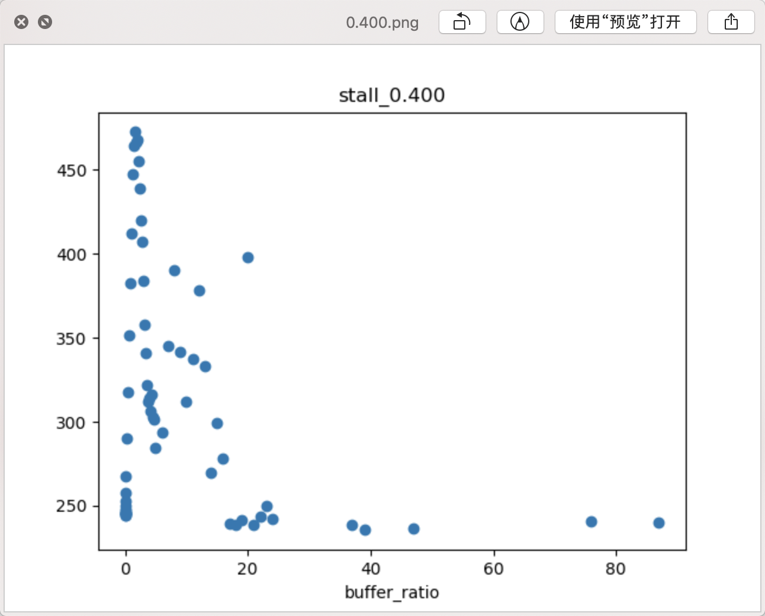
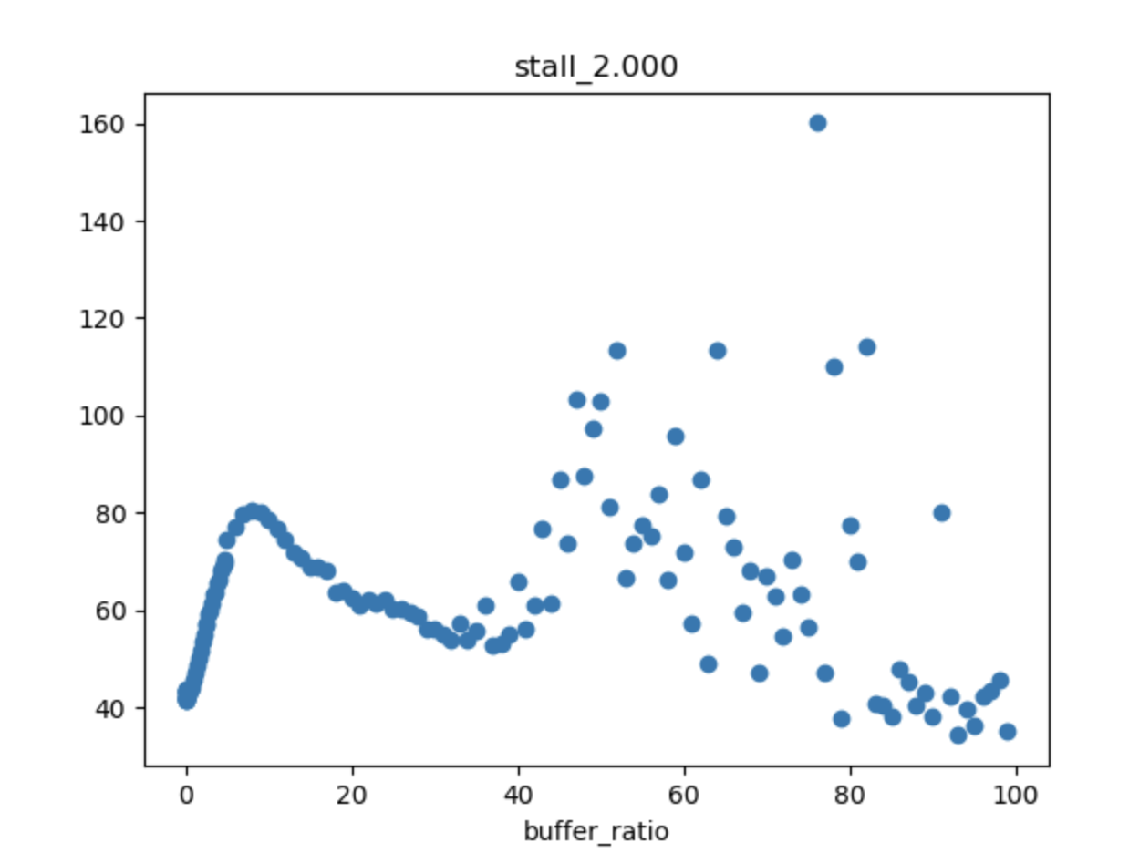
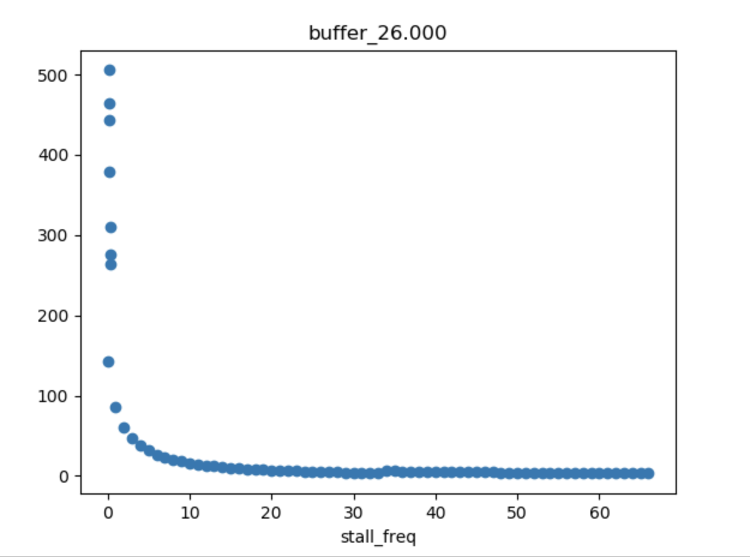
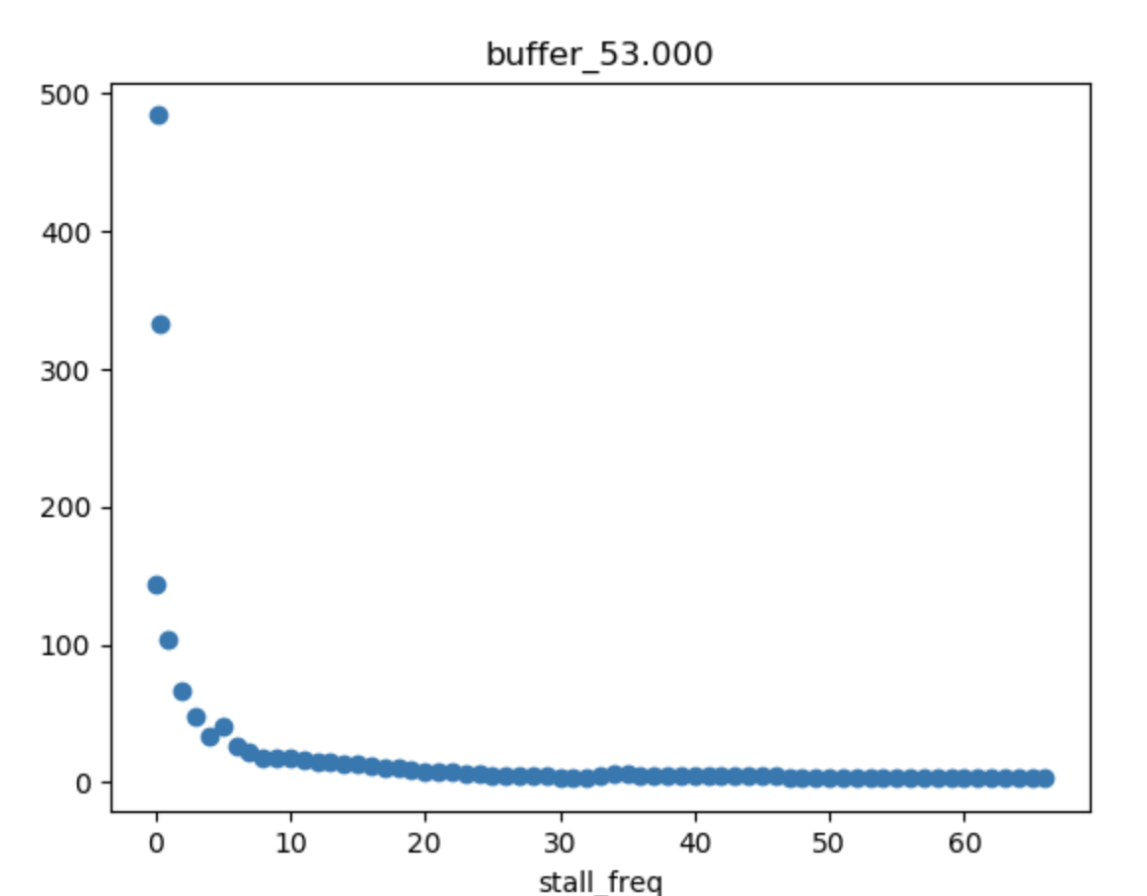
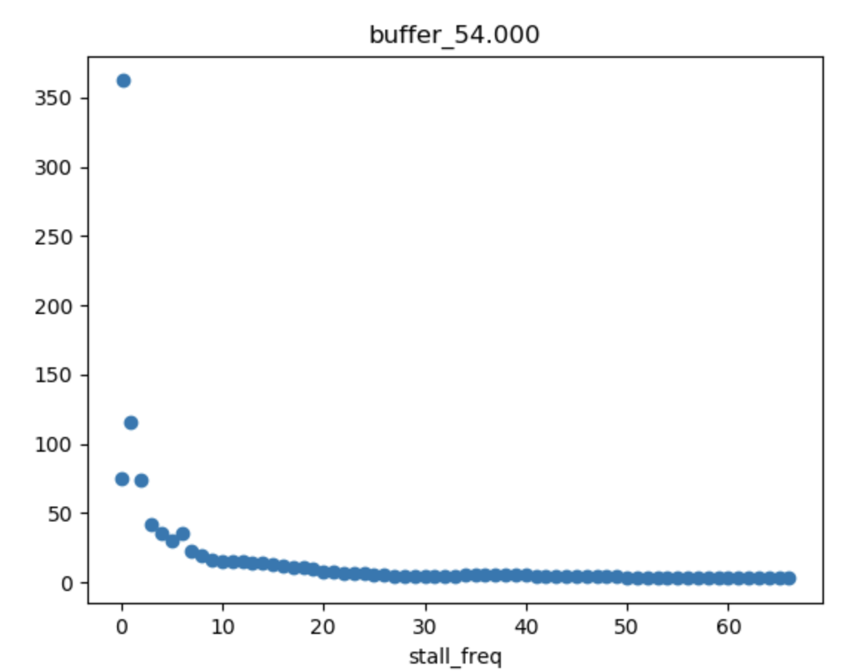

Slide 21
What’s the next
Heterogeneity → sensitivity
User:
User profile
QoE metrics (delay, stalling, bitrate), content
CDN:
CDN profile
QoE metrics
QoE
Data
Internship

